Slide 1
From Linear Models to Multi-layer Perceptrons
The content of these slides has been gathered from various online sources. We extend our sincere gratitude to everyone who has contributed their work.

Slide 2
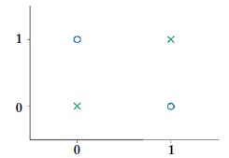
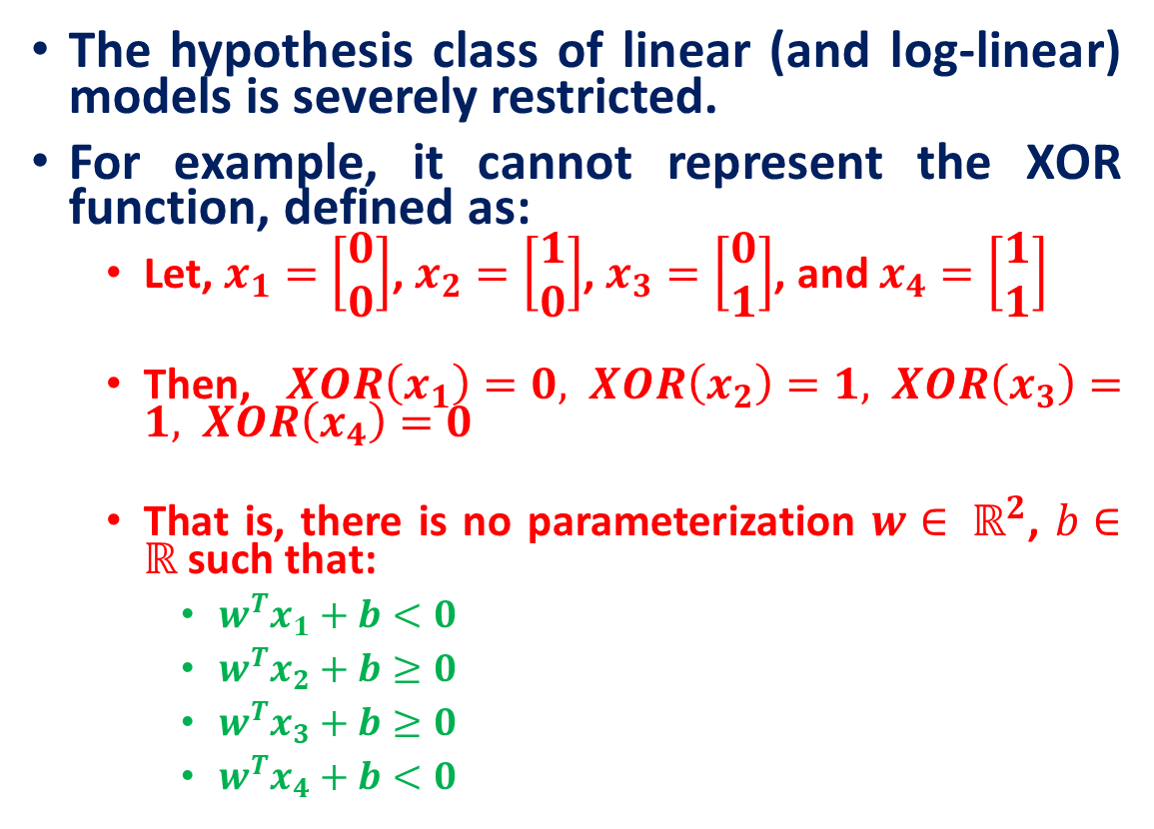
Limitations of Linear Models: The XOR Problem
The hypothesis class of linear (and log-linear) models is severely restricted.
For example, it cannot represent the XOR function, defined as:
Let, $x_{1}=\left[\begin{matrix}0 \\ 0\end{matrix}\right]$, $x_{2}=\left[\begin{matrix}1 \\ 0\end{matrix}\right]$, $x_{3}=\left[\begin{matrix}0 \\ 1\end{matrix}\right]$, and $x_{4}=\left[\begin{matrix}1 \\ 1\end{matrix}\right]$
Then, $XOR\left(x_{1}\right)=0, XOR\left(x_{2}\right)=1, XOR\left(x_{3}\right)=1, XOR\left(x_{4}\right)=0$
That is, there is no parameterization $w∈ ℝ^{2}$, $b∈ℝ$ such that:
$w^{T}x_{1}+b<0$
$w^{T}x_{2}+b≥0$
$w^{T}x_{3}+b≥0$
$w^{T}x_{4}+b<0$

Slide 3
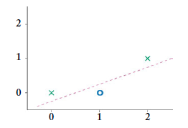
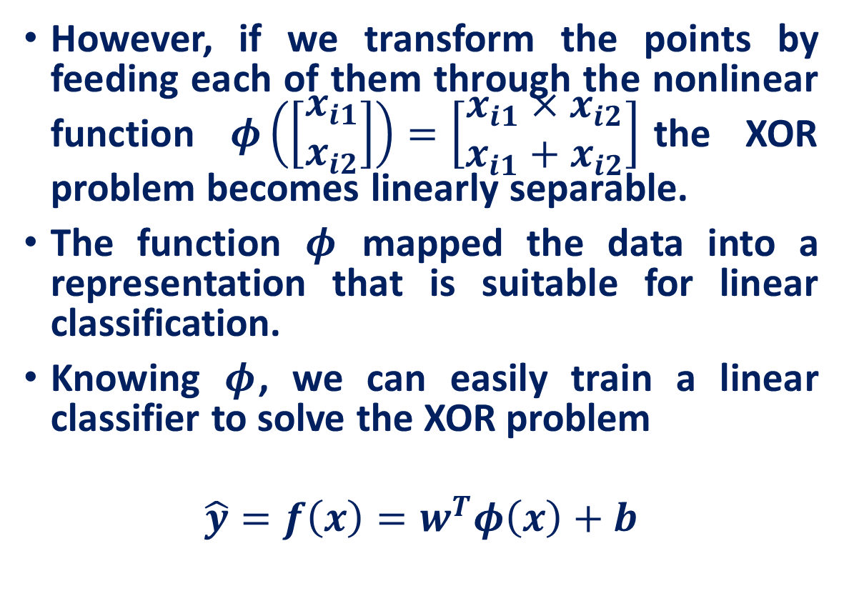
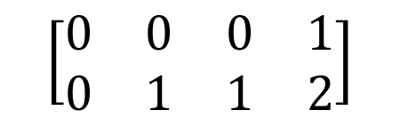
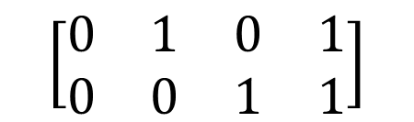
Nonlinear Input Transformations
However, if we transform the points by feeding each of them through the nonlinear function $φ\left(\left[\begin{aligned}x_{i1} \\ x_{i2}\end{aligned}\right]\right)=\left[\begin{aligned}x_{i1}×x_{i2} \\ x_{i1}+x_{i2}\end{aligned}\right]$the XOR problem becomes linearly separable.
The function $φ$ mapped the data into a representation that is suitable for linear classification.
Knowing $φ$, we can easily train a linear classifier to solve the XOR problem
$$\hat{y}=f\left(x\right)=w^{T}φ\left(x\right)+b$$
$$\left[\begin{matrix}0 & 1 & 0 & 1 \\ 0 & 0 & 1 & 1\end{matrix}\right]$$
$$\left[\begin{matrix}0 & 0 & 0 & 1 \\ 0 & 1 & 1 & 2\end{matrix}\right]$$

Slide 4
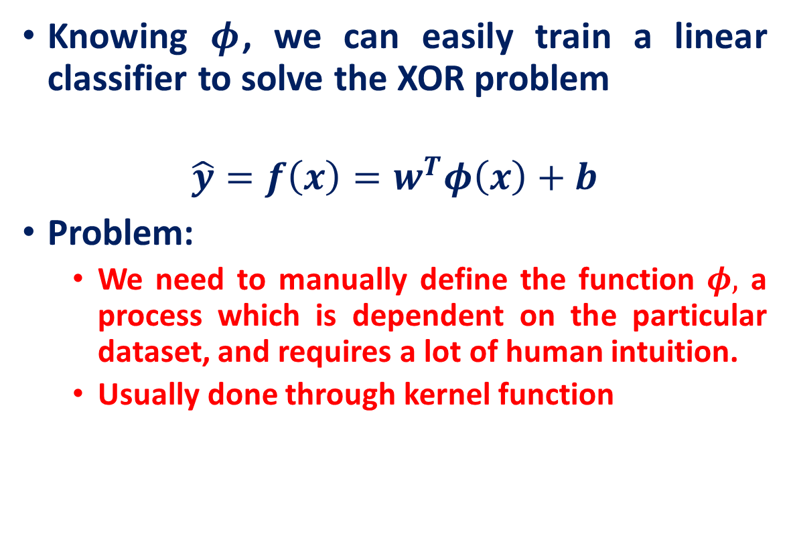
Nonlinear Input Transformations
Knowing $φ$, we can easily train a linear classifier to solve the XOR problem
$$\hat{y}=f\left(x\right)=w^{T}φ\left(x\right)+b$$
Problem:
We need to manually define the function $φ,$ a process which is dependent on the particular dataset, and requires a lot of human intuition.
Usually done through kernel function

Slide 5
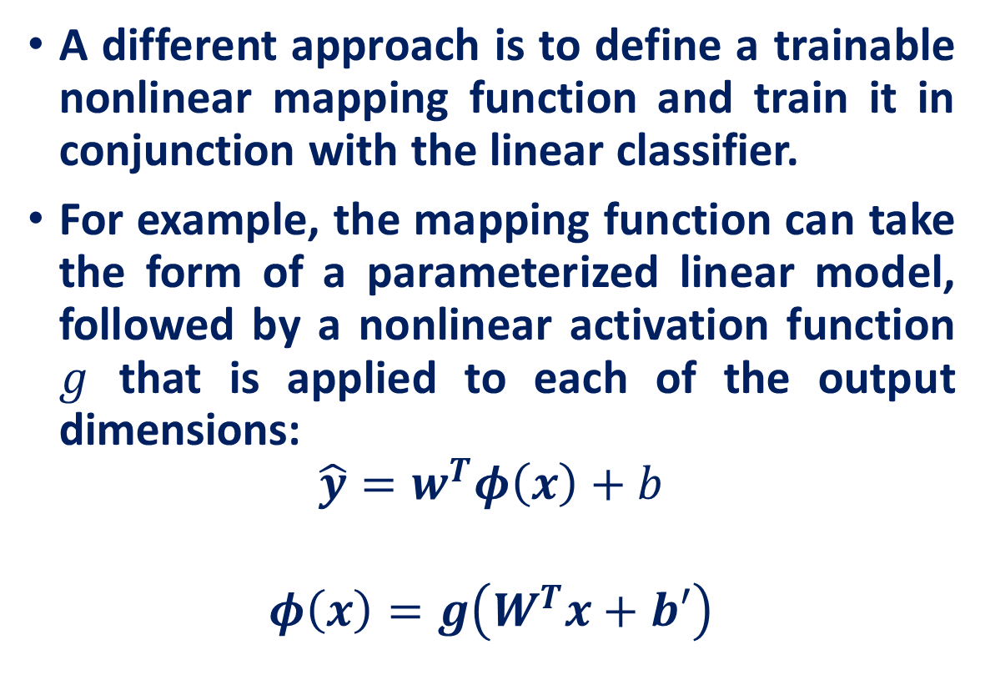
Trainable Mapping Functions
A different approach is to define a trainable nonlinear mapping function and train it in conjunction with the linear classifier.
For example, the mapping function can take the form of a parameterized linear model, followed by a nonlinear activation function $g$ that is applied to each of the output dimensions:
$$\hat{y}=w^{T}φ\left(x\right)+b$$
$$φ\left(x\right)=g\left(W^{T}x+b′\right)$$

Slide 6
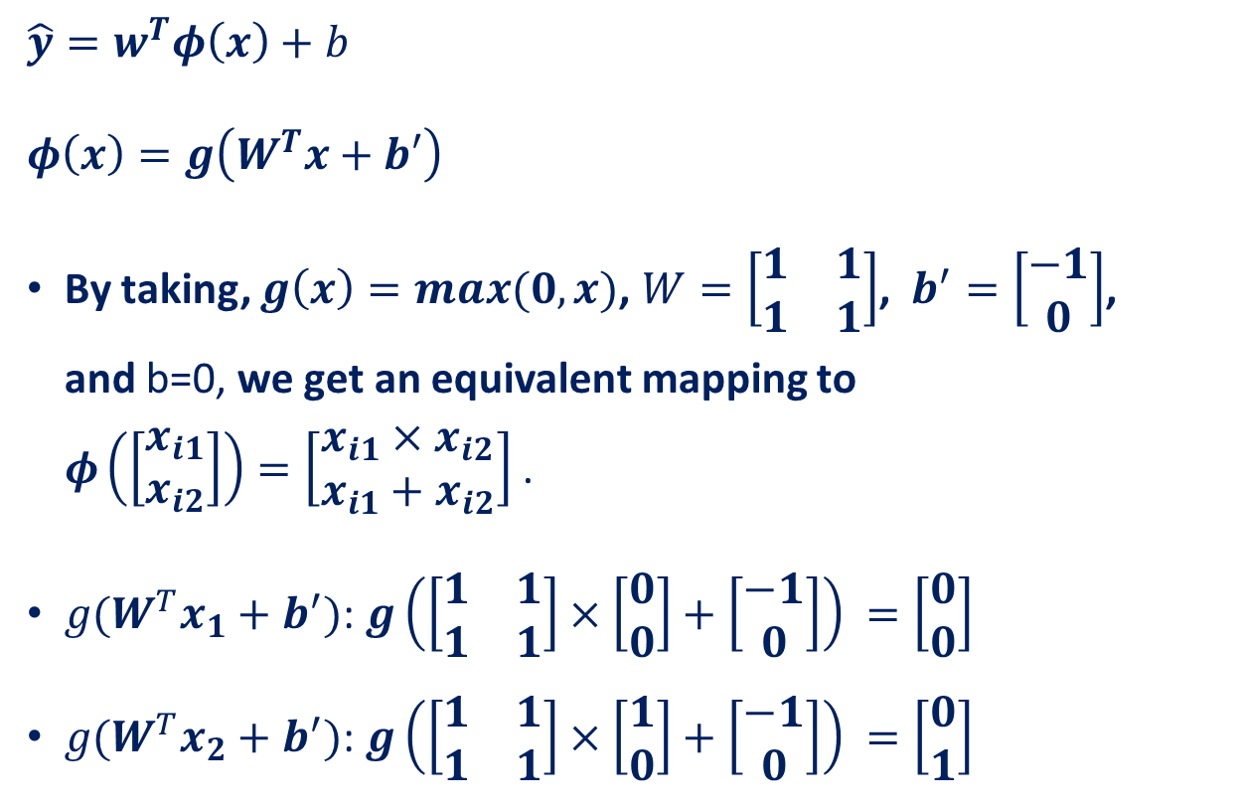
Trainable Mapping Functions
$$\hat{y}=w^{T}φ\left(x\right)+b$$
$$φ\left(x\right)=g\left(W^{T}x+b′\right)$$
By taking, $g\left(x\right)=max(0,x)$, $W=\left[\begin{matrix}1 & 1 \\ 1 & 1\end{matrix}\right]$, $b^{′}=\left[\begin{matrix}−1 \\ 0\end{matrix}\right]$, and b=0, we get an equivalent mapping to $φ\left(\left[\begin{aligned}x_{i1} \\ x_{i2}\end{aligned}\right]\right)=\left[\begin{aligned}x_{i1}×x_{i2} \\ x_{i1}+x_{i2}\end{aligned}\right]$ .
$g(W^{T}x_{1}+b^{′})$: $g\left(\left[\begin{matrix}1 & 1 \\ 1 & 1\end{matrix}\right]×\left[\begin{matrix}0 \\ 0\end{matrix}\right]+\left[\begin{matrix}−1 \\ 0\end{matrix}\right]\right) =\left[\begin{matrix}0 \\ 0\end{matrix}\right]$
$g(W^{T}x_{2}+b^{′})$: $g\left(\left[\begin{matrix}1 & 1 \\ 1 & 1\end{matrix}\right]×\left[\begin{matrix}1 \\ 0\end{matrix}\right]+\left[\begin{matrix}−1 \\ 0\end{matrix}\right]\right) =\left[\begin{matrix}0 \\ 1\end{matrix}\right]$
$$\left[\begin{matrix}0 & 1 & 0 & 1 \\ 0 & 0 & 1 & 1\end{matrix}\right]$$
$$\left[\begin{matrix}0 & 0 & 0 & 1 \\ 0 & 1 & 1 & 2\end{matrix}\right]$$

Slide 7

Trainable Mapping Functions
$$\hat{y}=w^{T}φ\left(x\right)+b$$
$$φ\left(x\right)=g\left(W^{T}x+b′\right)$$
By taking, $g\left(x\right)=max(0,x)$, $W=\left[\begin{matrix}1 & 1 \\ 1 & 1\end{matrix}\right]$, $b^{′}=\left[\begin{matrix}−1 \\ 0\end{matrix}\right]$, and b=0, we get an equivalent mapping to $φ\left(\left[\begin{aligned}x_{i1} \\ x_{i2}\end{aligned}\right]\right)=\left[\begin{aligned}x_{i1}×x_{i2} \\ x_{i1}+x_{i2}\end{aligned}\right]$ .
$g(W^{T}x_{3}+b^{′})$: $g\left(\left[\begin{matrix}1 & 1 \\ 1 & 1\end{matrix}\right]×\left[\begin{matrix}0 \\ 1\end{matrix}\right]+\left[\begin{matrix}−1 \\ 0\end{matrix}\right]\right) =\left[\begin{matrix}0 \\ 1\end{matrix}\right]$
$g(W^{T}x_{4}+b^{′})$: $g\left(\left[\begin{matrix}1 & 1 \\ 1 & 1\end{matrix}\right]×\left[\begin{matrix}1 \\ 1\end{matrix}\right]+\left[\begin{matrix}−1 \\ 0\end{matrix}\right]\right) =\left[\begin{matrix}1 \\ 2\end{matrix}\right]$
$$\left[\begin{matrix}0 & 1 & 0 & 1 \\ 0 & 0 & 1 & 1\end{matrix}\right]$$
$$\left[\begin{matrix}0 & 0 & 0 & 1 \\ 0 & 1 & 1 & 2\end{matrix}\right]$$

Slide 8
The Perceptron: A mathematical model of neuron

Slide 9
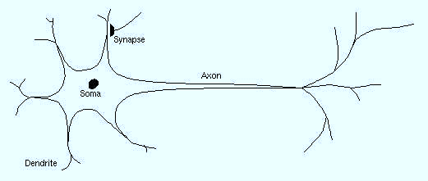
Biological Neurons
Dendrite: receives signals from other neurons
Synapse: point of connection to other neurons
Soma: processes the information
Axon: transmits the output of this neuron

Slide 10

The perceptron
The perceptron is a mathematical model of a biological neuron
While in actual neurons the dendrite receives electrical signals from the axons of other neurons, in the perceptron these electrical signals are represented as numerical values.
At the synapses between the dendrite and axons, electrical signals are modulated in various amounts.
This is also modeled in the perceptron by multiplying each input value by a value called the weight
$$Σ$$

Slide 11

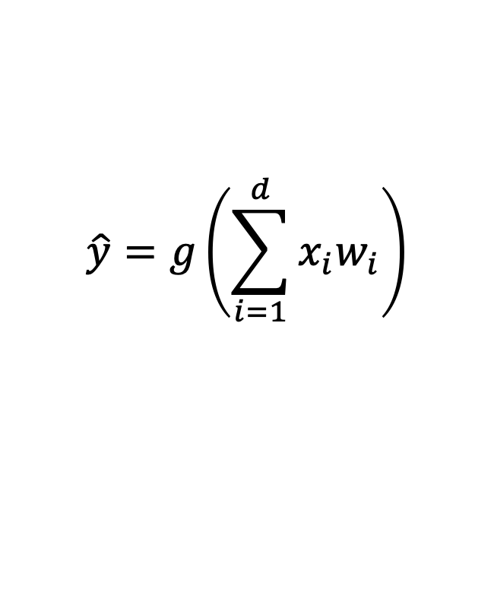


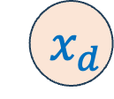

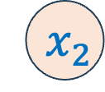

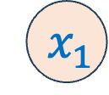

The perceptron
Let’s start with input $x∈ℝ^{d}$, which can be seen as signal transmitted by d numbers of connected perceptron.
Linear Combination of input features
Output
$${ x}_{1}$$
$$w_{1}$$
$$\hat{y}=g\left(\sum_{i=1}^{d}{x_{i}w_{i}}\right)$$
$${ x}_{2}$$
$$w_{2}$$
$$Σ$$
$$\hat{y}$$
.
.
.
$$w_{d}$$
$${ x}_{d}$$
Non-Linearity Activation Function
Input
Weights
Sum
Non-Linearity
Output

Slide 12

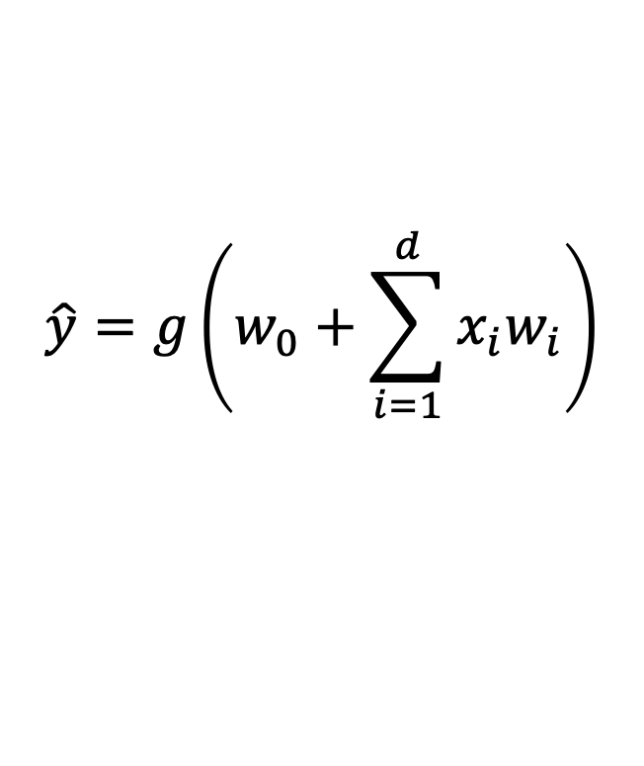

The perceptron
$$1$$
$$w_{0}$$
Linear Combination of input features
Output
$${ x}_{1}$$
$$w_{1}$$
$$\hat{y}=g\left(w_{0}+\sum_{i=1}^{d}{x_{i}w_{i}}\right)$$
$${ x}_{2}$$
$$w_{2}$$
$$Σ$$
$$\hat{y}$$
.
.
.
$$w_{d}$$
$${ x}_{d}$$
Bias
Non-Linearity Activation Function
Input
Weights
Sum
Non-Linearity
Output

Slide 13
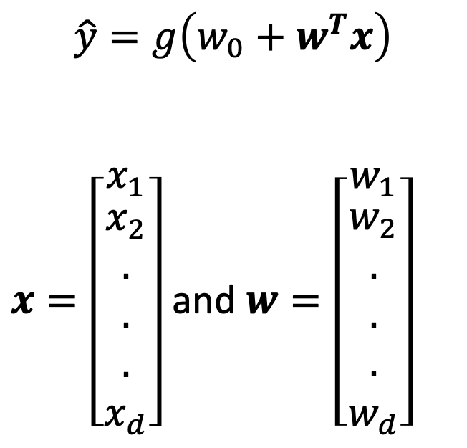
The perceptron
$$1$$
$$\hat{y}=g\left(w_{0}+w^{T}x\right)$$
$x=\left[\begin{matrix}x_{1} \\ \begin{aligned}x_{2} \\ . \\ . \\ . \\ x_{d}\end{aligned}\end{matrix}\right]$ and $w=\left[\begin{matrix}w_{1} \\ \begin{aligned}w_{2} \\ . \\ . \\ . \\ w_{d}\end{aligned}\end{matrix}\right]$
$$w_{0}$$
$${ x}_{1}$$
$$w_{1}$$
$${ x}_{2}$$
$$w_{2}$$
$$Σ$$
$$\hat{y}$$
.
.
.
$$w_{d}$$
$${ x}_{d}$$
Input
Weights
Sum
Non-Linearity
Output

Slide 14


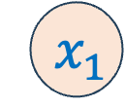





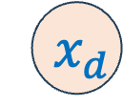

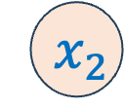

Building Neural Networks with Perceptron
The Perceptron: Simplified
$$\hat{y}=g\left(w_{0}+w^{T}x\right)$$
$$1$$
$$w_{0}$$
$${ x}_{1}$$
$$w_{1}$$
$$\hat{y}$$
$$w_{2}$$
$$∑$$
$${ x}_{2}$$
$$w_{d}$$
$$z=w_{0}+w^{T}x$$
$$\hat{y}=g\left(z\right)$$
.
.
.
$${ x}_{d}$$

Slide 15

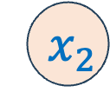
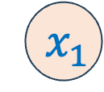
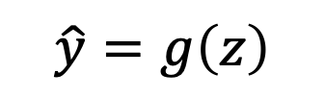
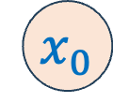
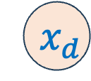
Feedforward Neural Networks
This is a particular class called “feedforward” networks.
Cascade neurons together
$$x_{0}$$
$${ x}_{1}$$
$$\hat{y}=g\left(z\right)$$
$${ x}_{2}$$
.
.
.
.
.
.
.
.
.
$${ x}_{d}$$

Slide 16
Feedforward Neural Networks
Inputs multiplied by initial set of weights
$$x_{0}$$
$${ x}_{1}$$
$$\hat{y}=g\left(z\right)$$
$${ x}_{2}$$
.
.
.
.
.
.
.
.
.
$${ x}_{d}$$

Slide 17
Feedforward Neural Networks
Intermediate “predictions” computed at first hidden layer
$$x_{0}$$
$${ x}_{1}$$
$$\hat{y}=g\left(z\right)$$
$${ x}_{2}$$
.
.
.
.
.
.
.
.
.
$${ x}_{d}$$

Slide 18
Feedforward Neural Networks
Intermediate “predictions” computed at first hidden layer
Predictions are fed forward through the network
$$x_{0}$$
$${ x}_{1}$$
$$\hat{y}=g\left(z\right)$$
$${ x}_{2}$$
.
.
.
.
.
.
.
.
.
$${ x}_{d}$$

Slide 19
Feedforward Neural Networks
Compute second set of intermediate predictions
$$x_{0}$$
$${ x}_{1}$$
$$\hat{y}=g\left(z\right)$$
$${ x}_{2}$$
.
.
.
.
.
.
.
.
.
$${ x}_{d}$$

Slide 20
Feedforward Neural Networks
Aggregate all the computations in the output
e.g. probability of a particular class
$$x_{0}$$
$${ x}_{1}$$
$$\hat{y}=g\left(z\right)$$
$${ x}_{2}$$
.
.
.
.
.
.
.
.
.
$${ x}_{d}$$

Slide 21
Feedforward Neural Networks
Aggregate all the computations in the output
e.g. probability of a particular class
$$x_{0}$$
$${ x}_{1}$$
$$\hat{y}=g\left(z\right)$$
Weight to learn!
Weight to learn!
Weight to learn!
$${ x}_{2}$$
.
.
.
.
.
.
.
.
.
$${ x}_{d}$$

Slide 22
Feedforward Neural Networks
neuron
Input
Layer 1
Layer 2
Layer L
Output
……
y₁
……
y₂
……
……
……
……
……
……
y_{M}
Input Layer
Hidden Layers
Output Layer
Deep means many hidden layers
Notes:
Fully Connected Feedforward Network
You can always connect the neurons in your own way.
“+” is ignored
Each dimension corresponds to a digit (10 dimension is needed)

Slide 23
How to train Neural Networks?
Forward propagation:
In this phase, the inputs for a training instance are fed into the neural network. This results in a forward cascade of computations across the layers, using the current set of weights.
Backpropagation
Way of computing the partial derivatives of a loss function with respect to the parameters of a network.
The method traverses the network in reverse order, from the output to the input layer, according to the chain rule from calculus.

Slide 24
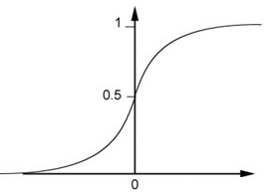
Example: Forward Pass
1
4
0.98
1
-2
1
-1
-2
0.12
-1
1
0
Sigmoid Function
Notes:
Ignore +

Slide 25
Example: Forward Pass
1
4
0.98
2
0.86
3
0.62
1
-2
-1
-1
1
0
-2
-1
-2
0.12
-2
0.11
-1
0.83
-1
1
-1
4
0
0
2

Slide 26
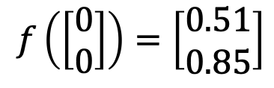

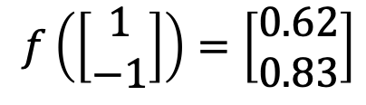
Example: Forward Pass
1
0.73
2
0.72
3
0.51
0
-2
-1
-1
1
0
-2
-1
0.5
-2
0.12
-1
0.85
0
1
-1
4
0
0
2
$$f:R^{2}→R^{2}$$
$$f\left(\left[\begin{matrix}1 \\ −1\end{matrix}\right]\right)=\left[\begin{matrix}0.62 \\ 0.83\end{matrix}\right]$$
$$f\left(\left[\begin{matrix}0 \\ 0\end{matrix}\right]\right)=\left[\begin{matrix}0.51 \\ 0.85\end{matrix}\right]$$
Different parameters define different function
Notes:
For example, if we modify “1” to “2”, then we have another function

Slide 27
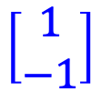


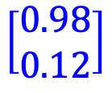


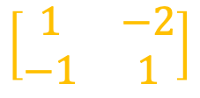
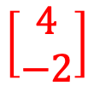
Forward Pass: Matrix Operation
1
4
0.98
1
-2
1
-1
-2
0.12
-1
1
0
$$\left[\begin{matrix}1 & −2 \\ −1 & 1\end{matrix}\right]$$
$$\left[\begin{matrix}1 \\ −1\end{matrix}\right]$$
$$\left[\begin{matrix}1 \\ 0\end{matrix}\right]$$
$$=$$
$$\left[\begin{matrix}0.98 \\ 0.12\end{matrix}\right]$$
$$σ\left( \right)$$
$$+$$
$$\left[\begin{matrix}4 \\ −2\end{matrix}\right]$$
Notes:
Make sure you know how to do it
author: Adam Coates, Baidu, Inc.
Deep Learning (hopefully faster)
http://videolectures.net/deeplearning2015_coates_deep_learning/

Slide 28
Forward Pass: Matrix Operation
……
y₁
W¹
W²
W^{L}
y₂
……
b^{L}
b¹
b²
……
……
……
……
……
x
a¹
a²
y
……
y_{M}
W¹
x
b¹
+
$$σ\left( \right)$$
W²
a¹
b²
+
$$σ\left( \right)$$
W^{L}
b^{L}
a^{L-1}
+
$$σ\left( \right)$$
Notes:
Draw it?

Slide 29

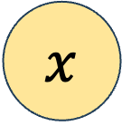
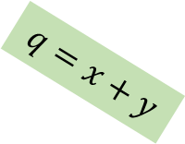


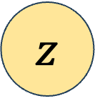
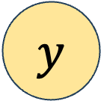

Computational Graph of Forward Propagation
Consider the function $f(x,y,z) = (x+y)z$
Gradient of this w.r.t. the parameters can be calculated by expanding the expression out.
However, the computation can be simplified by visualizing the computation as a graph.
$$x$$
$$+$$
$$y$$
$$q=x+y$$
$$z$$
$$∗$$
$$f=qz$$

Slide 30
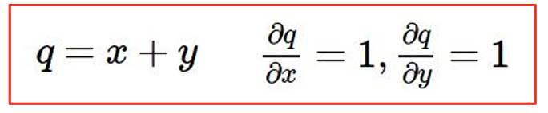
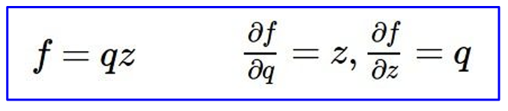

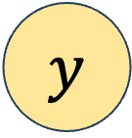

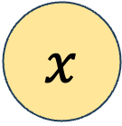
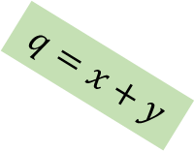
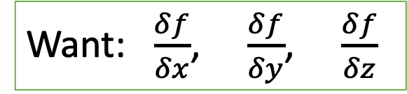

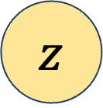
Backpropagation as a Computation Graph
$$x$$
$$+$$
$$y$$
$$q=x+y$$
$$z$$
$$∗$$
$$f=qz$$
Want: $\frac{δf}{δx}$, $\frac{δf}{δy}$, $\frac{δf}{δz}$

Slide 31
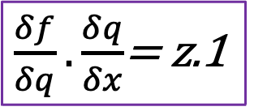
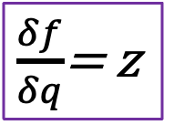


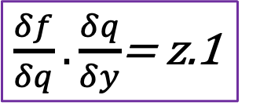
Backpropagation as a Computation Graph
$\frac{δf}{δq}.\frac{δq}{δx}$= z.1
$$x$$
$\frac{δf}{δq}$= z
$$+$$
$$y$$
$\frac{δf}{δq}.\frac{δq}{δy}$= z.1
$\frac{δf}{δz}$= q
$$f$$
$$z$$
$$∗$$
Want: $\frac{δf}{δx}$, $\frac{δf}{δy}$, $\frac{δf}{δz}$

Slide 32

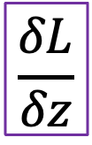








Backpropagation as a Computation Graph
$$\frac{δL}{δx}=\frac{δL}{δz}\frac{δz}{δx}$$
Local gradient
$$x$$
$$\frac{δz}{δx}$$
$$z$$
$$f$$
$$\frac{δz}{δy}$$
$$\frac{δL}{δz}$$
$$y$$
gradient
$$\frac{δL}{δy}=\frac{δL}{δz}\frac{δz}{δy}$$
Activations

Slide 33









Backpropagation with One Neuron
Consider:
Training data: $\left(x_{i},y_{i}\right)$,$1≤i≤N$, $x_{i}∈ℝ^{d}$, and $y_{i}∈ℝ$
Loss function to measure the deviation
$$L=\frac{1}{2}\sum_{i=1}^{N}{{\left(\hat{y_{i}}{− y}_{i}\right)}^{2}}$$
$\hat{y_{i}}$ is the prediction corresponding to instance $x_{i}$
$\hat{y_{i}}=w^{T}x_{i}={w_{1}x}_{1i}+{w_{1}x}_{2i}+…+{w_{1}x}_{di}$
$${\hat{y}}_{i}$$
$$w_{1}$$
$$w_{2}$$
$$w_{d}$$
$$…$$
$$x_{1i}$$
$$x_{2i}$$
$$x_{di}$$

Slide 34

Backpropagation with One Neuron
Want to update $w_{j}$, $1≤j≤d$
Update rule: $w_{j}←w_{j}−η\frac{∂L}{∂w_{j}}$
Now, corresponding to instance $x_{i}$
$$\frac{∂L}{∂w_{j}}=\frac{1}{2}.\frac{∂{\left(\hat{y_{i}}{− y}_{i}\right)}^{2}}{∂w_{j}}=2\left(\hat{y_{i}}{− y}_{i}\right)\frac{∂\left({w_{1}x}_{1i}+…+w_{d}x_{di}\right)}{∂w_{j}}$$
$$\frac{∂L}{∂w_{j}}=\left(\hat{y_{i}}{− y}_{i}\right)x_{ji}$$
$${\hat{y}}_{i}$$
$$w_{1}$$
$$w_{2}$$
$$w_{d}$$
$$…$$
$$x_{1i}$$
$$x_{2i}$$
$$x_{di}$$

Slide 35

Backpropagation with One Neuron
We have:
$$\frac{∂L}{∂w_{j}}=\left(\hat{y_{i}}{− y}_{i}\right)x_{ji}$$
Update Rule:
$$w_{j}←w_{j}−η\frac{∂L}{∂w_{j}}=w_{j}−η\left(\hat{y_{i}}{− y}_{i}\right)x_{ji}$$
$w_{j}←w_{j}−η\frac{∂L}{∂w_{j}}=w_{j}−ηδx_{ji}$, where $δ=\left(\hat{y_{i}}{− y}_{i}\right)$
$${\hat{y}}_{i}$$
$$w_{1}$$
$$w_{2}$$
$$w_{d}$$
$$…$$
$$x_{1i}$$
$$x_{2i}$$
$$x_{di}$$

Slide 36





















Backpropagation with Simple Feedforward Network
$${\hat{y}}_{i}=w_{1}^{(2)}z_{1i}+…+w_{k}^{(2)}z_{ki}$$
$${\hat{y}}_{i}$$
$z_{1i}=σ(a_{1i})$, where $a_{1i}=w_{11}^{(1)}x_{1i}+…+w_{d1}^{(1)}x_{di}$
Similarly, other $z_{ki}$’s
$$w_{1}^{(2)}$$
$$w_{k}^{(2)}$$
We want to find: $\frac{∂L}{∂w_{1}^{(2)}}, …, \frac{∂L}{∂w_{k}^{(2)}}$
$$z_{1i}$$
$$…$$
$$z_{ki}$$
$$w_{11}^{(1)}$$
$$w_{21}^{(1)}$$
$$w_{d1}^{(1)}$$
$$w_{1k}^{(1)}$$
$$w_{2k}^{(1)}$$
$$w_{dk}^{(1)}$$
C$onsider: \frac{∂L}{∂w_{1}^{(2)}}$ first,
$$\frac{∂L}{∂w_{1}^{(2)}}=\frac{1}{2}.\frac{∂{\left({\hat{y}}_{i}−y_{i}\right)}^{2}}{∂w_{1}^{(2)}}$$
$$…$$
$$x_{1i}$$
$$x_{2i}$$
$$x_{di}$$

Slide 37




Backpropagation with Simple Feedforward Network
$${\hat{y}}_{i}=w_{1}^{(2)}z_{1i}+…+w_{k}^{(2)}z_{ki}$$
$z_{1i}=σ(a_{1i})$, where $a_{1i}=w_{11}^{(1)}x_{1i}+…+w_{d1}^{(1)}x_{di}$
Similarly, other $z_{ki}$’s
$$\frac{∂L}{∂w_{1}^{(2)}}=\frac{1}{2}.\frac{∂{\left(\hat{y_{i}}{− y}_{i}\right)}^{2}}{∂w_{1}^{(2)}}$$
$=\left(\hat{y_{i}}{− y}_{i}\right)\frac{∂\left(w_{1}^{(2)}z_{1i}+…+w_{k}^{(2)}z_{ki}\right)}{∂w_{1}^{(2)}}$
$=\left(\hat{y_{i}}{− y}_{i}\right)z_{1i}=\frac{∂L}{∂\hat{y_{i}}}z_{1i}$
Local
Gradient

Slide 38

Backpropagation with Simple Feedforward Network
$${\hat{y}}_{i}=w_{1}^{(2)}z_{1i}+…+w_{k}^{(2)}z_{ki}$$
$z_{1i}=σ(a_{1i})$, where $a_{1i}=w_{11}^{(1)}x_{1i}+…+w_{d1}^{(1)}x_{di}$
Similarly, other $z_{ki}$’s
$$\frac{∂L}{∂w_{1}^{(2)}}=\frac{∂L}{∂\hat{y_{i}}}z_{1i}$$
$w_{1}^{(2)}=w_{1}^{(2)}−η\frac{∂L}{∂\hat{y_{i}}}z_{1i}$,
Similarly, $w_{k}^{(2)}=w_{k}^{(2)}−η\frac{∂L}{∂\hat{y_{i}}}z_{ki}$

Slide 39


Backpropagation with Simple Feedforward Network
$${\hat{y}}_{i}=w_{1}^{(2)}z_{1i}+…+w_{k}^{(2)}z_{ki}$$
$z_{1i}=σ(a_{1i})$, where $a_{1i}=w_{11}^{(1)}x_{1i}+…+w_{d1}^{(1)}x_{di}$
Similarly, other $z_{ki}$’s
So far, we have computed $\frac{∂L}{∂w_{1}^{(2)}}, …, \frac{∂L}{∂w_{k}^{(2)}}$
Now, we have to compute:
$\frac{∂L}{∂w_{11}^{(1)}}, …, \frac{∂L}{∂w_{d1}^{\left(1\right)}},…,\frac{∂L}{∂w_{dk}^{\left(1\right)}}$

Slide 40

Backpropagation with Simple Feedforward Network
$${\hat{y}}_{i}=w_{1}^{(2)}z_{1i}+…+w_{k}^{(2)}z_{ki}$$
$z_{1i}=σ(a_{1i})$, where $a_{1i}=w_{11}^{(1)}x_{1i}+…+w_{d1}^{(1)}x_{di}$
Similarly, other $z_{ki}$’s
Let’s compute: $\frac{∂L}{∂w_{11}^{(1)}}$
$$=\frac{1}{2}.\frac{∂{\left(\hat{y_{i}}{− y}_{i}\right)}^{2}}{∂w_{11}^{(1)}}$$
$$=\left(\hat{y_{i}}{− y}_{i}\right)\frac{∂\left(w_{1}^{(2)}z_{1i}+…+w_{k}^{(2)}z_{ki}\right)}{∂w_{11}^{(1)}}$$

Slide 41

Backpropagation with Simple Feedforward Network
$${\hat{y}}_{i}=w_{1}^{(2)}z_{1i}+…+w_{k}^{(2)}z_{ki}$$
$z_{1i}=σ(a_{1i})$, where $a_{1i}=w_{11}^{(1)}x_{1i}+…+w_{d1}^{(1)}x_{di}$
Similarly, other $z_{ki}$’s
Let’s compute: $\frac{∂L}{∂w_{11}^{(1)}}$
$$=\left(\hat{y_{i}}{− y}_{i}\right)w_{1}^{(2)}\frac{∂\left(σ(a_{1i})\right)}{∂w_{11}^{(1)}}$$

Slide 42

Backpropagation with Simple Feedforward Network
$${\hat{y}}_{i}=w_{1}^{(2)}z_{1i}+…+w_{k}^{(2)}z_{ki}$$
$z_{1i}=σ(a_{1i})$, where $a_{1i}=w_{11}^{(1)}x_{1i}+…+w_{d1}^{(1)}x_{di}$
Similarly, other $z_{ki}$’s
Let’s compute: $\frac{∂L}{∂w_{11}^{(1)}}$
$$=\left(\hat{y_{i}}{− y}_{i}\right)w_{1}^{(2)}σ^{′}\left(a_{1i}\right).\frac{∂\left(a_{1i}\right)}{∂w_{11}^{(1)}}$$

Slide 43

Backpropagation with Simple Feedforward Network
$${\hat{y}}_{i}=w_{1}^{(2)}z_{1i}+…+w_{k}^{(2)}z_{ki}$$
$z_{1i}=σ(a_{1i})$, where $a_{1i}=w_{11}^{(1)}x_{1i}+…+w_{d1}^{(1)}x_{di}$
Similarly, other $z_{ki}$’s
Let’s compute: $\frac{∂L}{∂w_{11}^{(1)}}$
$$=\left(\hat{y_{i}}{− y}_{i}\right)w_{1}^{(2)}σ^{′}\left(a_{1i}\right).x_{1i}$$
$$=\frac{∂L}{∂{\hat{y}}_{i}}.\frac{∂{\hat{y}}_{i}}{∂z_{1i}}.\frac{∂z_{1i}}{∂w_{11}^{(1)}}$$
Local
Gradient

Slide 44

Backpropagation with Simple Feedforward Network
$${\hat{y}}_{i}=w_{1}^{(2)}z_{1i}+…+w_{k}^{(2)}z_{ki}$$
$z_{1i}=σ(a_{1i})$, where $a_{1i}=w_{11}^{(1)}x_{1i}+…+w_{d1}^{(1)}x_{di}$
Similarly, other $z_{ki}$’s
$$\frac{∂L}{∂w_{11}^{(1)}}=\frac{∂L}{∂{\hat{y}}_{i}}.\frac{∂{\hat{y}}_{i}}{∂z_{1i}}.\frac{∂z_{1i}}{∂w_{11}^{(1)}}$$
Similarly,
$$\frac{∂L}{∂w_{pq}^{(1)}}=\frac{∂L}{∂{\hat{y}}_{i}}.\frac{∂{\hat{y}}_{i}}{∂z_{qi}}.\frac{∂z_{qi}}{∂w_{pq}^{(1)}}$$

Slide 45
References
Neural Network Methods for Natural Language Processing, Yoav Goldberg
Introduction to Deep Learning, Alexander Amini, MIT Introduction to Deep Learning
On Predictive and Generative Deep Neural Architectures, Prof. Swagatam Das, ISICAL
http://wavelab.uwaterloo.ca/wp-content/uploads/2017/04/Lecture_3.pdf
https://heartbeat.fritz.ai/deep-learning-best-practices-regularization-techniques-for-better-performance-of-neural-network-94f978a4e518
https://cedar.buffalo.edu/~srihari/CSE676/7.12%20Dropout.pdf
http://speech.ee.ntu.edu.tw/~tlkagk/courses/ML_2017/Lecture/DNN%20tip.pptx
Accelerating Deep Network Training by Reducing Internal Covariate Shift, Jude W. Shavlik
http://speech.ee.ntu.edu.tw/~tlkagk/courses/MLDS_2018/Lecture/ForDeep.pptx
Deep Learning Tutorial. Prof. Hung-yi Lee, NTU.
Lecture 4: Backpropagation and Neural Networks part 1, Fei-Fei Li & Andrej Karpathy & Justin Johnson

